Slide 1

Department of Information Science and Engineering Minor Project (18IS64) - 6th Semester B.E.
Auto Gradation of Handwritten Mathematical Answer Sheets Phase III Evaluation
2020-21
Adamyaa D N (1RV18IS002)
Ananya G M (1RV18IS006)
Varshini P (1RV18IS058)
S. G. Raghavendra Prasad
Assistant Professor

Slide 2

Go, change the world
RV College of
Engineering
Agenda
Introduction
Topic Relevance to Information Science
Domain Knowledge
Literature Survey
Formulation of Objectives
Methodology
Societal Relevance
Design
Implementation
Testing
Results and Analysis
Conclusion
References

Slide 3
Go, change the world
RV College of
Engineering
Introduction
Grading is an essential part of education. Assessing each answer sheet manually, offering fair, unbiased and valid grades is difficult most of the time.
Although the printed text recognition is considered as a clarified issue, handwritten text recognition remains as a demanding task.
The proposed system attempts to develop a computer vision algorithm along with a solution package for recognizing and digitizing steps of solving a mathematical equation written by freehand on a paper, validating the steps and final answer of the recognized handwritten lines by maintaining the context.

Slide 4
Go, change the world
RV College of
Engineering
Topic Relevance to Information Science
Optical Character Recognition in the field of Natural Language Processing.
Automating frequent sequence of actions in everyday life using various machine algorithms, hence an amazing leap of advancements can be observed in the field of data science.
Computer Vision and Convolutional Neural Networks which are the fundamental pillars of Artificial Intelligence and Machine Learning.

Slide 5
Go, change the world
RV College of
Engineering
Domain Knowledge
Computer Vision and OpenCV
Tesseract
OCRopus
Binarization
Machine Learning
Datasets: MNIST, Kaggle’s Handwritten Mathematical Symbols
Deep Columnar Convolutional Neural Network

Slide 6
Go, change the world
RV College of
Engineering
Literature Survey
TITLE | AUTHOR & YEAR OF PUBLICATION | OBJECTIVE | DATA | METHODOLOGY | CONCLUSION
Automated Grading for Handwritten Answer Sheets using CNN | Emran Shaikh, Ayisha Manzoor, Ghazanfar Latif & Iman Ahmed Mohiuddin. October 2019. | The objective was to automatically grade handwritten answer sheets. | 250 students were given answer sheets with 20 questions each, obtained a total of 5080 segmented images. | Model 1 consisted of 4 CNN layers and 3 dense layers. Model 2 consisted of 4 CNN layers and 4 dense layers. | Model 1 produced 92.866 and model 2 produced 92.322 accuracy.
Automatically Solving Number Word Problems by Semantic Parsing and Reasoning | Shuming Shi , Yuehui Wang , Chin-Yew Lin , Xiaojiang Liu and Yong Rui. | The objective was to solve number word problems automatically and produce accurate answers | The problems set contained 1,878 math number word problems, collected from two web sites: algebra.com6 and answers.yahoo.com7 | DOL language was used for semantic representation. CFG was used as semantic parser. KAZB and Basicsum baseline methods were implemented. | The approach achieves a particularly high precision of 95%. That means once an answer is provided by our approach, it has a very high probability of being correct.

Slide 7
Go, change the world
Literature Survey
RV College of
Engineering
TITLE | AUTHOR & YEAR OF PUBLICATION | OBJECTIVE | DATA | METHODOLOGY | CONCLUSION
Deep Columnar Convolutional Neural Network | Somshubra Majumdar, Ishaan Jain. July 2016. | The objective was to observe the performance of DCNN model and compare it with the performance of other top models. | MNIST dataset - It is a dataset of 60,000 small square 28×28 pixel grayscale images of handwritten single digits between 0 and 9. | Deep Convolutional Neural Networks is used. Adadelta learning algorithm used as optimizer. Works on MNIST dataset. | DCNN method has near state of the art performance using only a single model and obtains slightly better results.

Slide 8
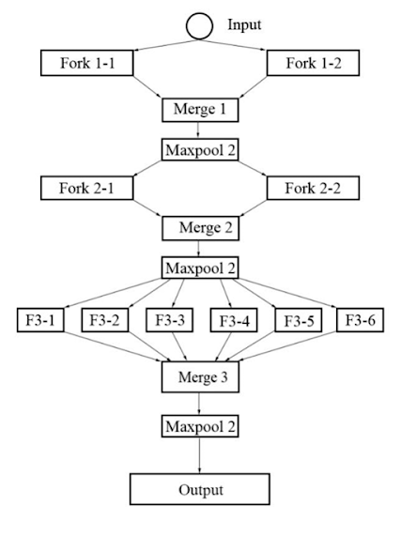
Go, change the world
RV College of
Engineering
Deep Columnar Convolutional Neural Network
Methodology
Deep Convolutional Neural Networks is used.
Adadelta learning algorithm used as optimizer.
Trained on MNIST dataset.
Architecture
Wide Architecture
Deep Architecture
GPU Processing
Pooling via Convolution Subsampling
Variable Kernel Size
Fork Layers
Merge Layers
DCCNN Architecture for MNIST Dataset

Slide 9
Go, change the world
RV College of
Engineering
Objectives
The following are the broad modules that will be catered to, towards the realization of the end objective of the project:
Workspace Detection using valid markers in the sheet
Detecting and localizing each single lines
Perform Optical Character Recognition in each detected line
Evaluating each line and providing feedback in terms of red/green bounding box drawn across it where green represents correct and red represents wrong answers.

Slide 10
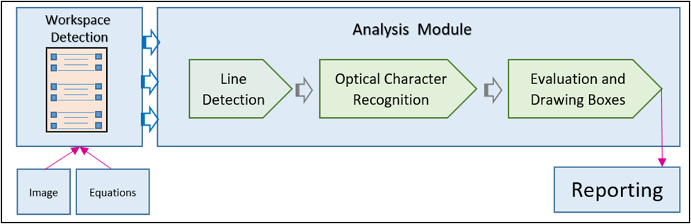
Go, change the world
RV College of
Engineering
Methodology

Slide 11
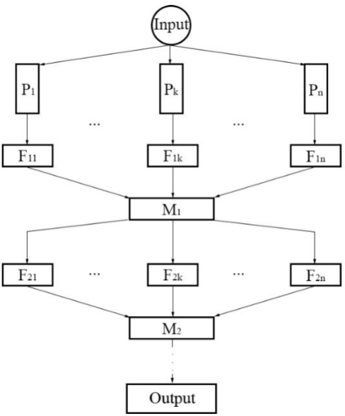
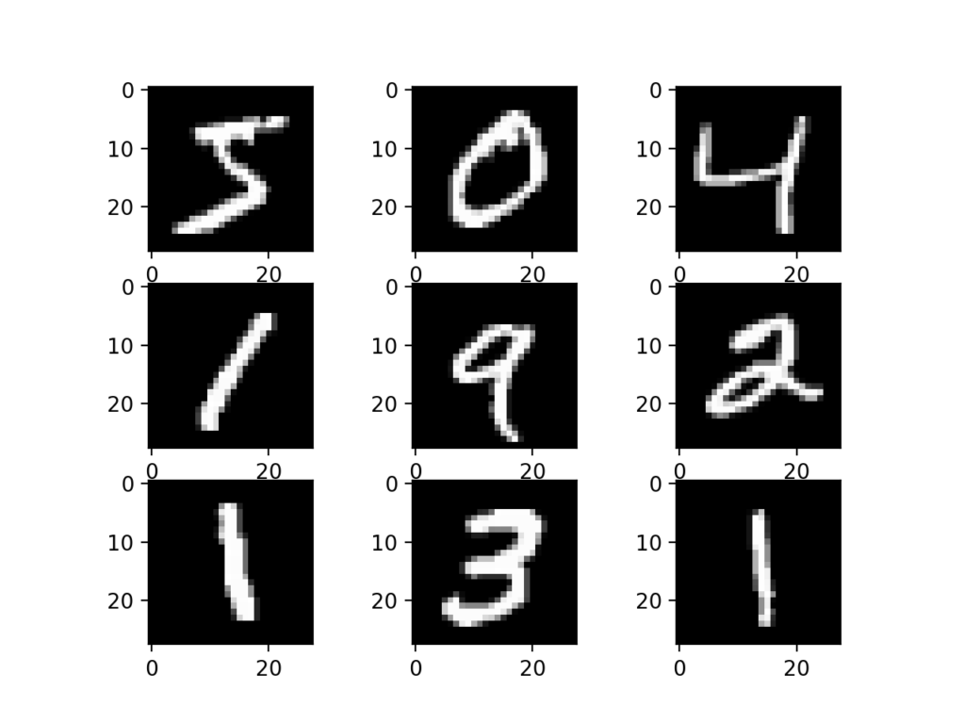
Go, change the world
RV College of
Engineering
MNIST Dataset
Deep Columnar Convolutional Neural Network

Slide 12
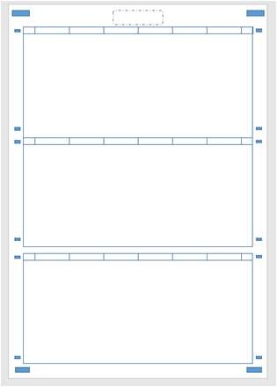
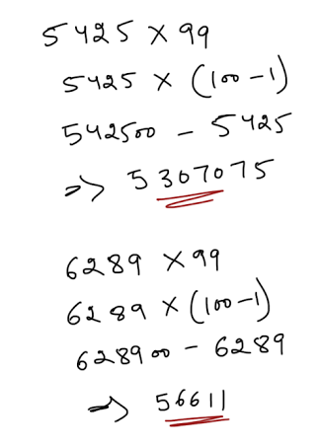
Go, change the world
RV College of
Engineering
Workspace

Slide 13
Go, change the world
RV College of
Engineering
Design
Workspace Detection Module:
Finding closed object contours (rectangular boxes)
Sorting the contours (top-to-bottom) based on the coordinates
Choosing the desired boxes based on the area.
Analysis Module:
Binarization
Line detection using forward derivative
Character Recognition:
Deep Columnar Convolutional Neural Network

Slide 14
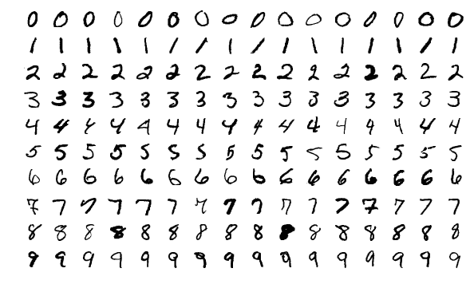
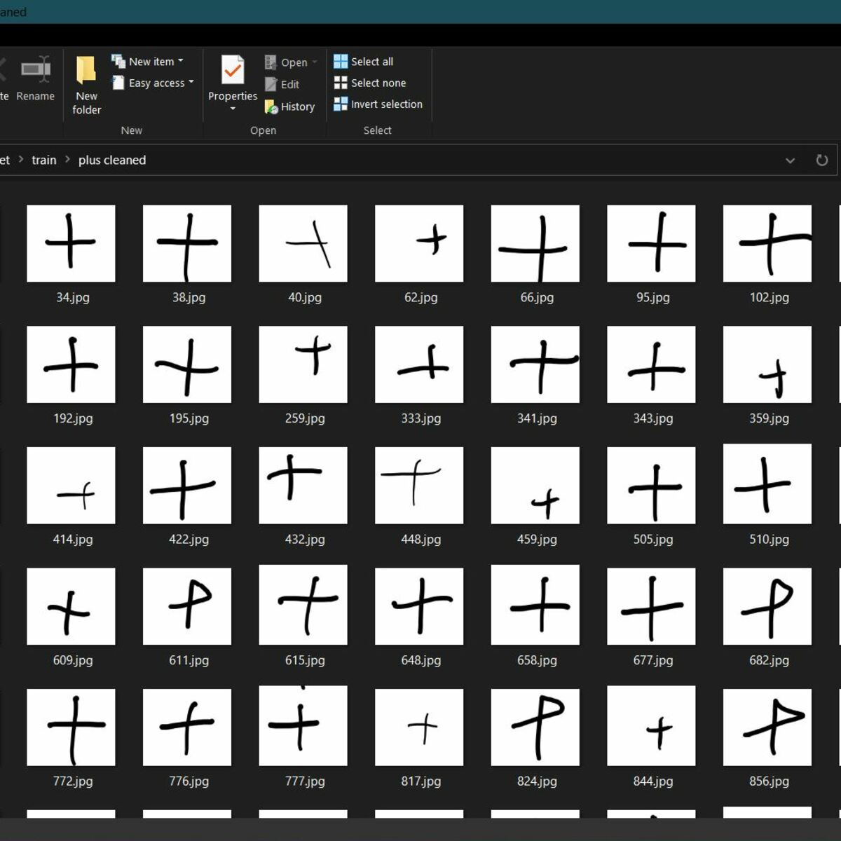
Go, change the world
RV College of
Engineering
Implementation
Data :
Total no of images: 62,250
No of classes:15
Classes: ['0', '1', '2', '3', '4', '5', '6', '7', '8', '9', '+', '-', 'times', '(', ')']
Training data: Validation data = 8:2
Training: Softmax and ReLu activation, Adadelta optimizers
Tesseract: OCR engine and LSTM Neural network

Slide 15
Go, change the world
RV College of
Engineering
Test Suite 1 : DCCNN Training
Training and Validation Split
Parameter training
Accuracy
Test Suite 2 : Workspace Detection
Rectangle formation
Length and Width
Test Suite 3 : Line Detection
Noise removal
Line formation
Test Suite 4 : Character Segmentation
Exponential Detection
Character Detection
Test Suite 5 : Equation Evaluation
Processing B/W images
Saving results
Testing

Slide 16
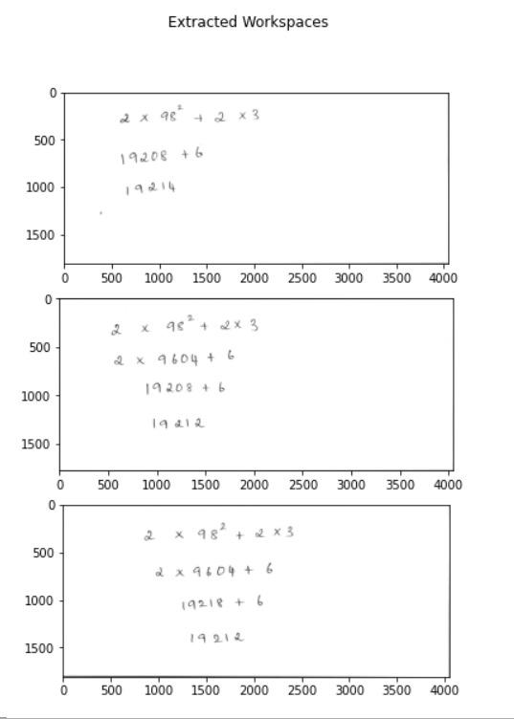
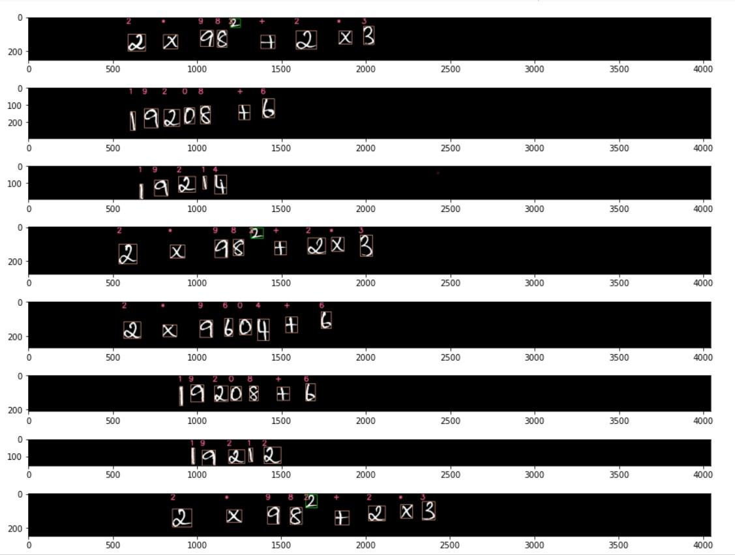
Workspace Detection
Character Segmentation

Slide 17
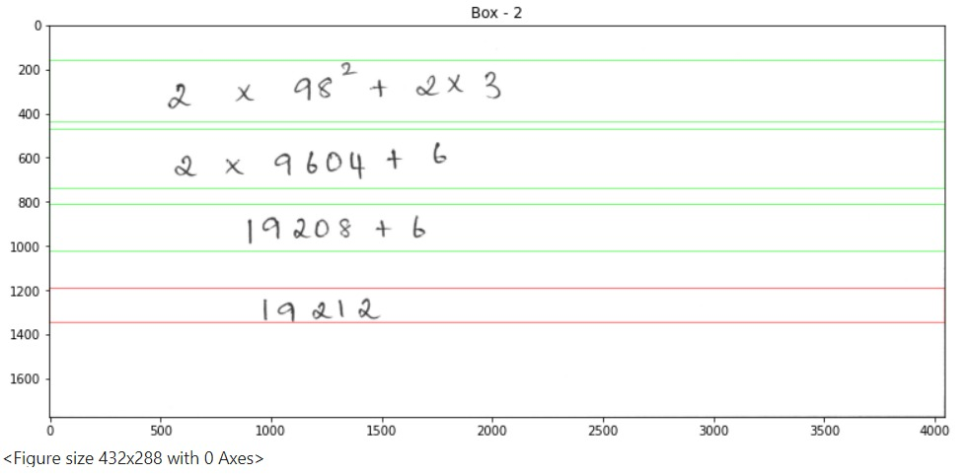
Go, change the world
RV College of
Engineering
Results and Analysis
The result of the equation is indicated by colored bounding boxes
Red bounding boxes - Incorrect answer
Green bounding box - Correct answer
Blue bounding box - Undetermined (Needs manual evaluation)

Slide 18
Go, change the world
RV College of
Engineering
Societal Relevance
Educational institutions such as universities, schools and various learning centres are an integral part of the society.
Examinations and grading hold a significant role in the functioning of these institutions.
Although grading is typically seen as a manual job, it can be observed that a much higher efficiency can be achieved by automating the process.
The automated grading system reduces the amount of human errors, increases speed and thereby produces highly reliable output.

Slide 19
Go, change the world
RV College of
Engineering
Conclusion
Educational institutions such as universities, schools and various learning centres are an integral part of the society.
Examinations and grading hold a significant role in the functioning of these institutions.
Although grading is typically seen as a manual job, it can be observed that a much higher efficiency can be achieved by automating the process.
The automated grading system reduces the amount of human errors, increases speed and thereby produces highly reliable output.

Slide 20
Go, change the world
RV College of
Engineering
References
Multi-Scale Attention with Dense Encoder for Handwritten Mathematical Expression Recognition- Paper on Offline math formula recognition. Validated on CROHME dataset.
Image-to-Markup Generation with Coarse-to-Fine Attention – This paper presents attention based encoder-decoder model to convert images to Latex. Validated on CROHME dataset.
MNIST as jpgs - This page contains MNIST images in jpg format.
Handwritten mathematical symbols dataset – Kaggle’s dataset on handwritten mathematical symbols, extracted and modified from CROHME dataset.
https://github.com/pannous/tensorflow-ocr

